Slide 1
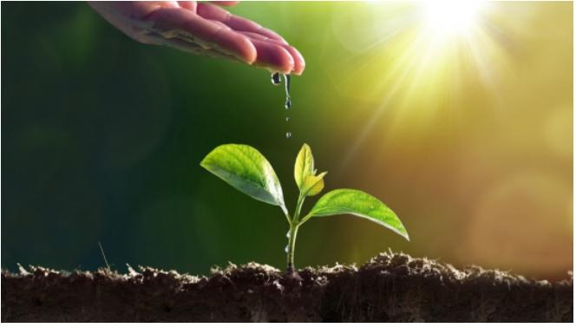
To develop automatic irrigation system by use of waste water for small irrigation field
“FARMING IS A PROFESSION OF HOPE”

Slide 2
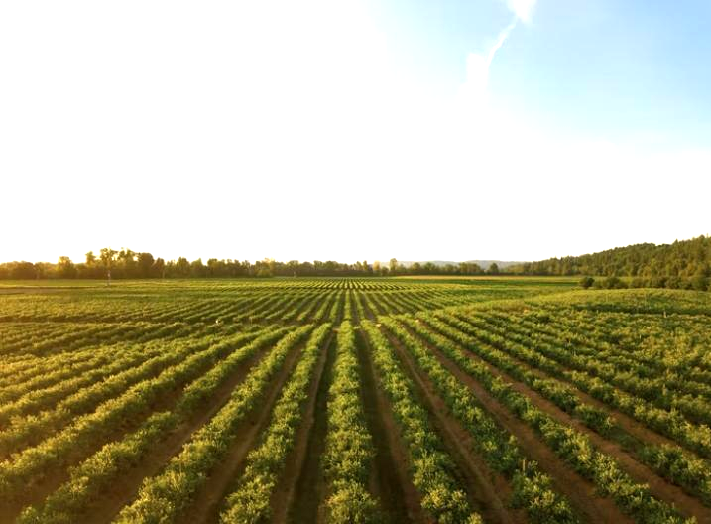
INTRODUCTION
Agriculture is the need of most of the people’s livelihood and it is one of the main sources of the Indian economy..
By using traditional methods , farmers are struggling hard in the agriculture field, mainly in the task of irrigation and it is quite difficult for the farmers due to lack of regularity in their work and negligence..
Primitive irrigative system causes many drawbacks as it falls to conserve water and human energy ,so that we are introducing automatic irrigation system by using IOT..
By using internet of things and sensor technology we can use waste water to the field very effectively . Hence it can improve the utilization of water and it can increase productivity..

Slide 3

SOFTWARE
REQUIREMENTS
HARDWARE
REQUIREMENTS
Power supply block
Microcontroller(at mega 16)
LED
LCD
Relay(5v)
BC547 Transistor
Cyclic control unit
Resistors & capacitors
Soil moisture sensor
Humidity sensor
Temperature sensor
KEIL compiler
Language embedded C
Machine learning

Slide 4

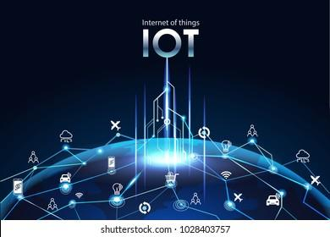
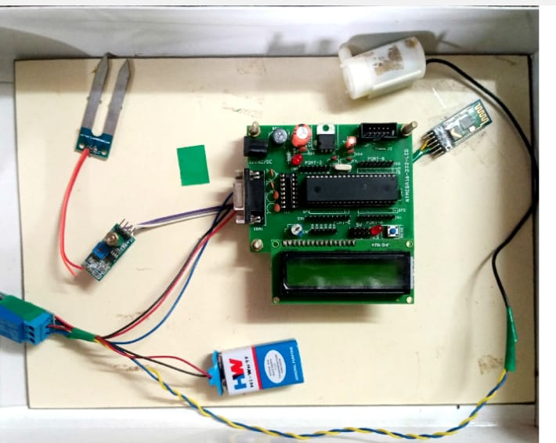
VARIOUS METHODS
Soil moisture sensor with IOT (SIM card)..
Soil moisture sensor with IOT (WIFI)..
Cyclic control unit with float valve..
By using machine learning in microcontroller..

Slide 5
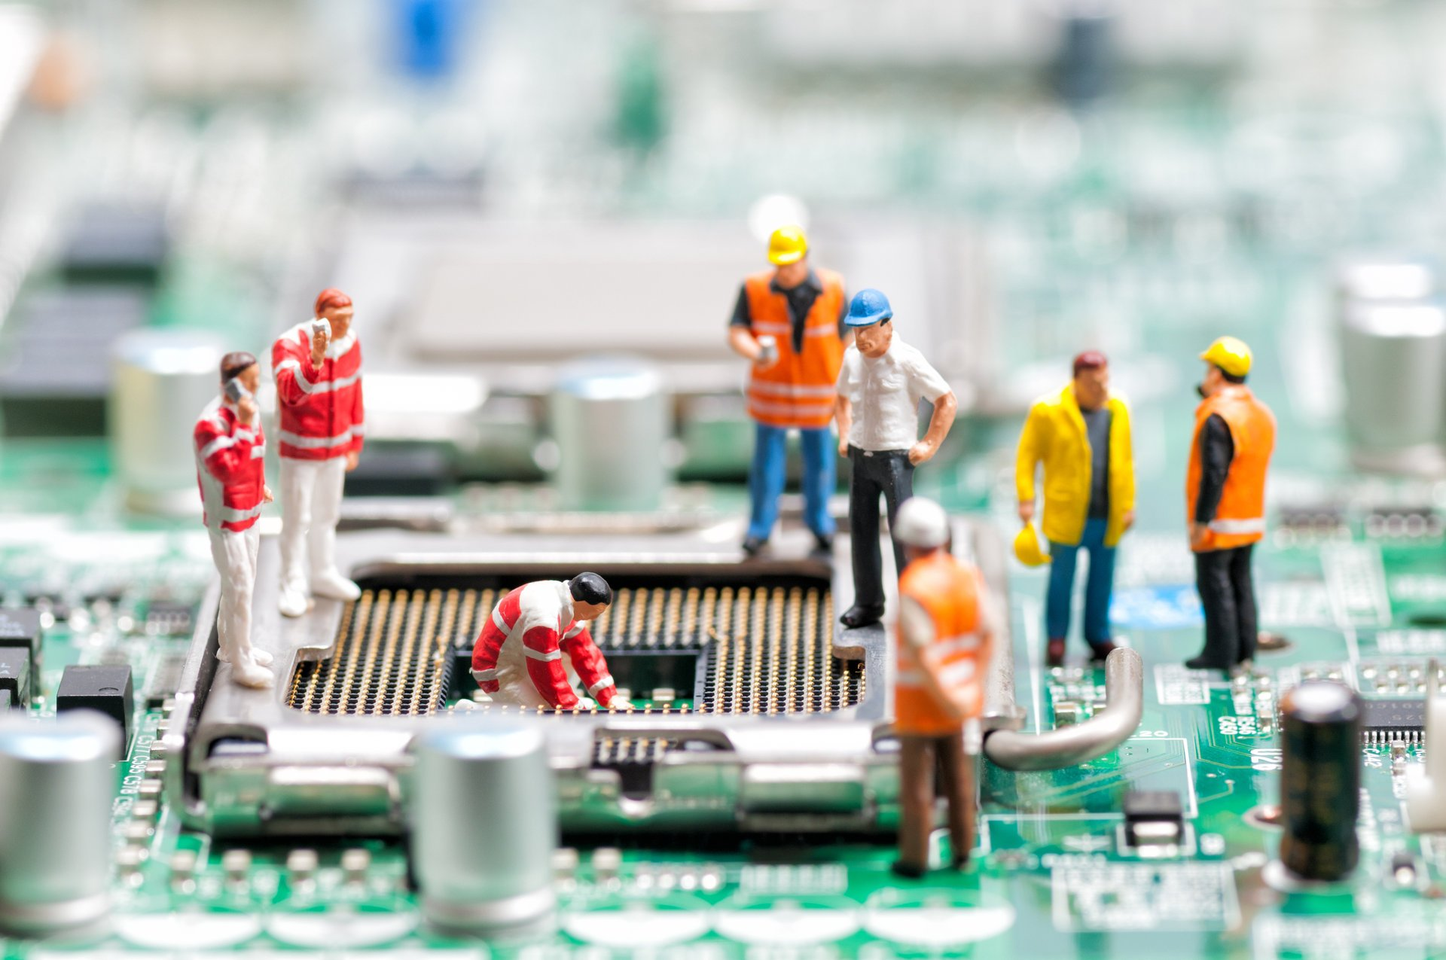
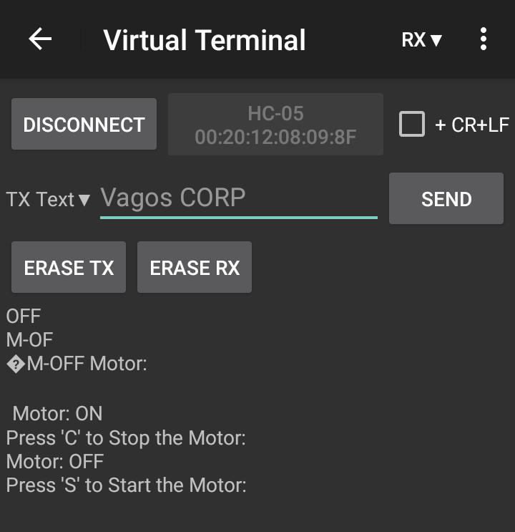
Block diagram
To required components
Power
supply
Sensor
ATMEGA 16
Micro
controller
LED Display
LM358
Bluetooth
Relay
Water pump
motor

Slide 6

WORKING PRINCIPLE
This project uses ATMEGA series microcontroller which is programmed to receive the input signal of varying moisture condition of the sensing environment..
This is achieved by using an op-amp as comparator which acts as interface between the sensing arrangement and the microcontroller..
Once the controller receives this signal , it generates an output that drives a relay for operating the water pump..
Here we use bluetooth for short distance communiucation to transfer all the information to the mobile phone.In real life we will use IOT instead of bluetooth for long distance communication..
An LCD display is also interfaced to the microcontroller to display status of the soil and water pump..
The sensing arrangement is made two stiff metallic rods inserted into the field at a distance or sensor…

